Slide 1
Programming fundamentals
Lecture 18: Pointers, pass by pointer, dereferencing a pointer

Slide 2
Recap
Passing 2D arrays
Static variables
Function overloading
Introduction to pointers

Slide 3
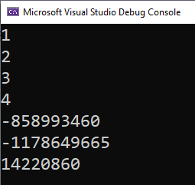
1D array and functions
arr
1 | 2 | 3 | 4 | -858993460 | -1178649665 | 14220860 | -1228649665 | -778649665
0FXX0
0 | 1 | 2 | 3 | 4 | 5 | 6 | 7 | 8
#include <iostream>
using namespace std;
void print(int arr[])
{
for (int i=0;i<7;i++)
{
cout << arr[i] << " " << endl;
}
}
int main()
{
int arr[4] = {1,2,3,4};
print(arr);
return 0;
}

Slide 4
2D array
#include <iostream>
using namespace std;
void print(int arr[][3])
{
for (int i = 0; i < 2; i++)
{
for (int j=0 ; j<3 ; j++)
{
cout << "Value arr[" << i <<","<<j<< "]: " << arr[i][j] << " " << endl;
cout << "Address arr[" << i << "," << j << "]: " << &arr[i][j] << " " << endl;
}
}
}
int main()
{
int arr[2][3] = {1,2,3,4,5,6};
print(arr);
return 0;
}
0 | 007CFE5C | 1
1 | 007CFE60 | 2
2 | 007CFE64 | 3
3 | 007CFE68 | 4
4 | 007CFE6C | 5
5 | 007CFE70 | 6
6 | 007CFE74 | -858993460
7 | 007CFE78 | 1636287196
8 | 007CFE7C | 8191644
9 | 007CFE80 | 3485315
10 | 007CFE84 | 1
11 | 007CFE88 | 12214168
12 | 007CFE8C | 12232232
13 | 007CFE90 | 1
14 | 007CFE94 | 12214168
15 | ……
0,0 | 0,1 | 0,2
007CFE5C | 007CFE60 | 007CFE64
1 | 2 | 3
1,0 | 1,1 | 1,2
007CFE68 | 007CFE6C | 007CFE70
4 | 5 | 6

Slide 5
#include <iostream>
using namespace std;
void print(int arr[][3])
{
for (int i = 0; i < 5; i++)
{
for (int j=0 ; j<5 ; j++)
{
cout << "Value arr[" << i <<","<<j<< "]: " << arr[i][j] << " " << endl;
cout << "Address arr[" << i << "," << j << "]: " << &arr[i][j] << " " << endl;
}
}
}
int main()
{
int arr[2][3] = {1,2,3,4,5,6};
print(arr);
return 0;
}

Slide 6
0,0 | 0,1 | 0,2 | 0,3 | 0,4
007CFE5C | 007CFE60 | 007CFE64 | 007CFE68 | 007CFE6C
1 | 2 | 3 | 4 | 5
1,0 | 1,1 | 1,2 | 1,3 | 1,4
007CFE68 | 007CFE6C | 007CFE70 | 007CFE74 | 007CFE78
4 | 5 | 6 | -858993460 | 1636287196
2,0 | 2,1 | 2,2 | 2,3 | 2,4
007CFE74 | 007CFE78 | 007CFE7C | 007CFE80 | 007CFE84
-858993460 | 1636287196 | 8191644 | 3485315 | 1
3,0 | 3,1 | 3,2 | 3,3 | 3,4
007CFE80 | 007CFE84 | 007CFE88 | 007CFE8C | 007CFE90
3485315 | 1 | 12214168 | 12232232 | 1
4,0 | 4,1 | 4,2 | 4,3 | 4,4
007CFE8C | 007CFE90 | 007CFE94 | 007CFE8C | 007CFE90
12232232 | 1 | 12214168 | 12232232 | 1
0 | 007CFE5C | 1
1 | 007CFE60 | 2
2 | 007CFE64 | 3
3 | 007CFE68 | 4
4 | 007CFE6C | 5
5 | 007CFE70 | 6
6 | 007CFE74 | -858993460
7 | 007CFE78 | 1636287196
8 | 007CFE7C | 8191644
9 | 007CFE80 | 3485315
10 | 007CFE84 | 1
11 | 007CFE88 | 12214168
12 | 007CFE8C | 12232232
13 | 007CFE90 | 1
14 | 007CFE94 | 12214168
15 | ……

Slide 7
Agenda
Using Pointers
Dereferencing a pointer
Pass by pointer

Slide 8
Pointers
A pointer is a variable that contains a memory address. Very often this address is the location of another variable. For example, if x contains the address of y, then x is said to "point to" y.
two special operators that are used with pointers: * and &.
Pointer variables must be declared as such. The general form of a pointer variable declaration is
type *var-name;
#include <iostream>
using namespace std;
int main()
{
int* p;
double *q;
return 0;
}
While declaration, use asterisk between data type and variable name
Asterik can stick to wither data type or variable name (both are fine)

Slide 9
Declaration and definition
#include <iostream>
using namespace std;
int main()
{
int* p;
int x;
double *q;
double y;
p = &x;
q = &y;
return 0;
}
p
x
0FF10
0FXX0
Garbage
0FXX0
Declaration
p = & x;
Definition
pointer
Some variable
Ampersand
sign

Slide 10
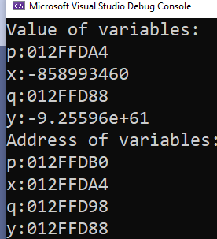
example
#include <iostream>
using namespace std;
int main()
{
int* p;
int x;
double *q;
double y;
p = &x;
q = &y;
cout << "Value of variables:" << endl;
cout << "p:" << p << endl;
cout << "x:" << x << endl;
cout << "q:" << q << endl;
cout << "y:" << y << endl;
cout << "Address of variables:" << endl;
cout << "p:" << &p << endl;
cout << "x:" << &x << endl;
cout << "q:" << &q << endl;
cout << "y:" << &y << endl;
return 0;
}
The addresses you see when you run the program may differ
from those shown here, but the net effect will be the same
Pointer p holding the address of variable x

Slide 11
* operator
Remember we used * while declaring pointer
We can also use * to extract/fetch the value pointed by the pointer. (also known as dereferencing)
#include <iostream>
using namespace std;
int main()
{
int* p; int x = 7;
p = &x;
cout << "Value present at the location pointed by p:" << *p << endl;
return 0;
}

Slide 12
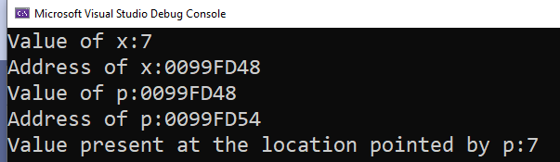
#include <iostream>
using namespace std;
int main()
{
int* p; int x = 7;
cout << "Value of x:" << x << endl;
cout << "Address of x:" << &x << endl;
p = &x;
cout << "Value of p:" << p << endl;
cout << "Address of p:" << &p << endl;
cout << "Value present at the location pointed by p:" << *p << endl;
return 0;
}
p
x
0099FD48
0099FD54
7
0099FD48

Slide 13
Assigning Values Through a Pointer
p = &x;
Pointer/address
address
#include <iostream>
using namespace std;
int main()
{
int* p; int x = 7;
int* q; int y = 9;
//while assigning value, make sure L.H.S matches with R.H.S
p = &x;
q = &y;
int* r, *s;
r = p;
s = q;
return 0;
}
r = p;
Pointer/address
Pointer/address
p
q
x
y
0FXY0
0FXX0
0FXY9
0FXX4
7
0FXY0
9
0FXY9
r
s
p
q
x
y
0FXY0
0FFF0
0FXY9
0FFF4
0FXY0
0FXX0
0FXY9
0FXX4
7
0FXY0
9
0FXY9

Slide 14
Change the value of variables indirectly using pointers
*p = 17;
value
value
#include <iostream>
using namespace std;
int main()
{
int* p; int x = 7;
int* q; int y = 9;
p = &x;
q = &y;
*p = 17;
*q = *q + 10;
return 0;
}
*q = *q+10;
value
value
p
q
x
y
0FXY0
0FXX0
0FXY9
0FXX4
7
0FXY0
9
0FXY9
p
q
x
y
0FXY0
0FXX0
0FXY9
0FXX4
17
0FXY0
19
0FXY9

Slide 15
Incrementing pointer vs incrementing value pointed by a pointer
#include <iostream>
using namespace std;
int main()
{
int* p; int x = 7;
p = &x;
cout << "p:" << p << endl;
cout << "*p:" << *p << endl;
cout << "&p:" << &p << endl;
cout << "&x:" << &x << endl;
(*p)++;
cout << "p:" << p << endl;
cout << "*p:" << *p << endl;
cout << "&p:" << &p << endl;
cout << "&x:" << &x << endl;
p++;
cout << "p:" << p << endl;
cout << "*p:" << *p << endl;
cout << "&p:" << &p << endl;
cout << "&x:" << &x << endl;
return 0;
}

Slide 16
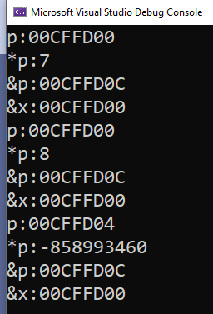
(*p)++ will indirectly print the value! p++ will increment in the contents of p (that is an address), therefore immediate next location (to variable x) address gets stored in p. Since its an int pointer therefore 4 bytes difference is there between consecutive locations.
#include <iostream>
using namespace std;
int main()
{
int* p; int x = 7;
p = &x;
cout << "p:" << p << endl;
cout << "*p:" << *p << endl;
cout << "&p:" << &p << endl;
cout << "&x:" << &x << endl;
(*p)++;
cout << "p:" << p << endl;
cout << "*p:" << *p << endl;
cout << "&p:" << &p << endl;
cout << "&x:" << &x << endl;
p++;
cout << "p:" << p << endl;
cout << "*p:" << *p << endl;
cout << "&p:" << &p << endl;
cout << "&x:" << &x << endl;
return 0;
}
x
00CFFD00 | 7
00CFFD04 | -858993460
00CFFD0C | 00CFFD00
p

Slide 17
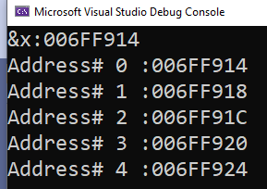
Print the address of 5 memory locations, immediate next to x
#include <iostream>
using namespace std;
int main()
{
int* p; int x = 7;
p = &x;
cout << "&x:" << &x << endl;
for (int i = 0; i < 5; i++)
cout << "Address# " << i << " :" << p++ << endl;
return 0;
}

Slide 18
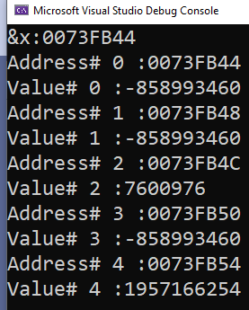
Print the address of 5 memory locations, immediate next to x and also print the values present at these locations
#include <iostream>
using namespace std;
int main()
{
int* p; int x = 7;
p = &x;
cout << "&x:" << &x << endl;
for (int i = 0; i < 5; i++)
{
cout << "Address# " << i << " :" << p++ << endl;
cout << "Value# " << i << " :" << *p << endl;
}
return 0;
}

Slide 19
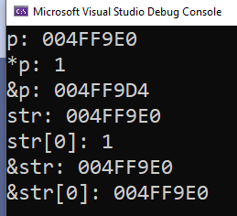
Pointers and Arrays
Since array’s name depicts base address therefore we can assign it to a pointer.
Provided that array type and pointer type matches
#include <iostream>
using namespace std;
int main()
{
int arr[4] = {1,2,3,4};
int* p;
p = arr;
cout << "p: " << p << endl;
cout << "*p: " << *p << endl;
cout << "&p: " << &p << endl;
cout << "str: " << arr << endl;
cout << "str[0]: " << arr[0] << endl;
cout << "&str: " << &arr << endl;
cout << "&str[0]: " << &arr[0] << endl;
return 0;
}

